Slide 1

Sales Forecasting for a Retail Chain(POC)
Team name: Try it at your own risk!

Slide 2
Data Description
Most of the fields are self-explanatory. The following are descriptions for those that aren't.
Id - an Id that represents a (Store, Date) duple within the test set
Store - a unique Id for each store
Sales - the turnover for any given day (this is what you are predicting)
Customers - the number of customers on a given day
Open - an indicator for whether the store was open: 0 = closed, 1 = open

Slide 3

Problem Statement
We have a retail chain with 1115 stores, where we would like to forecast the total sales sales, provide visibility to the managers to improve their inventory management practice.
In this POC we identified the top 20 stores accounting for the most sales and we created a prophet model to forecast the sales for the next 42 days.

Slide 4
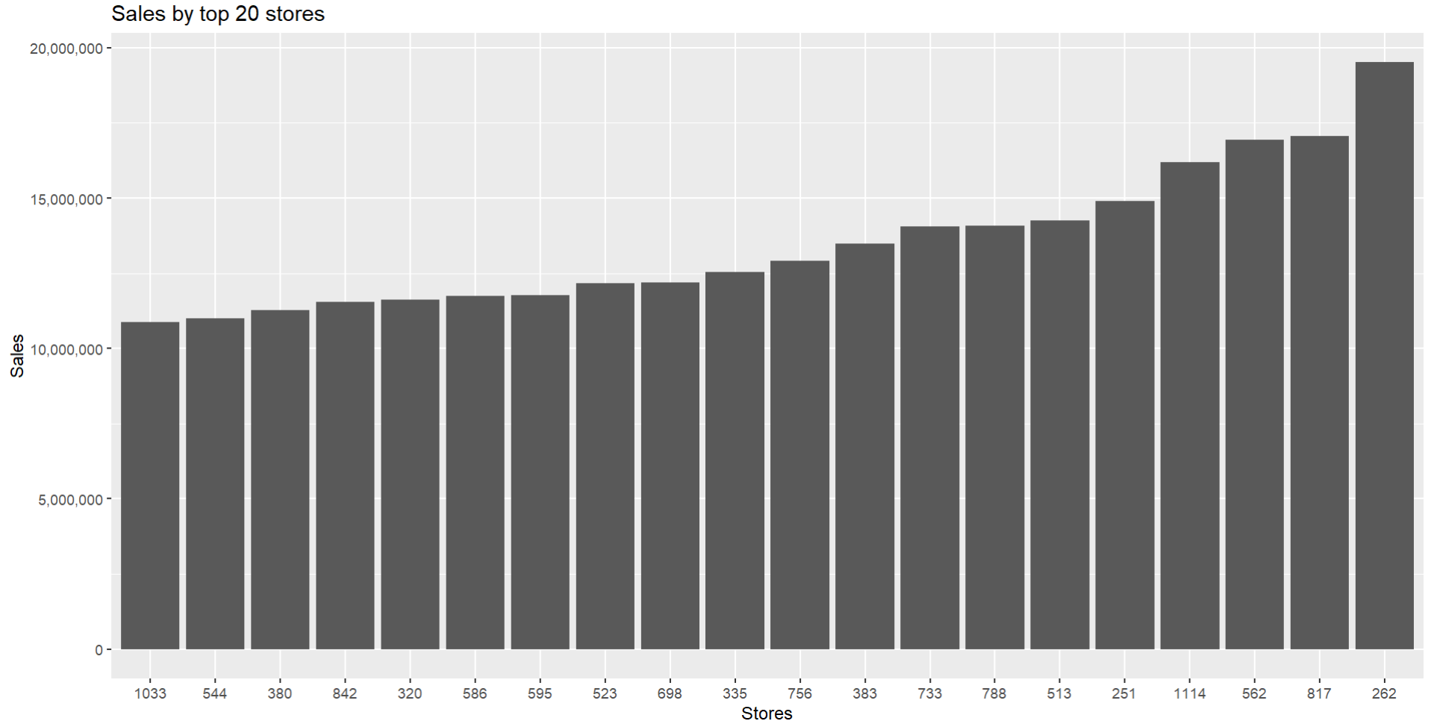
Sales by top 20 stores

Slide 5
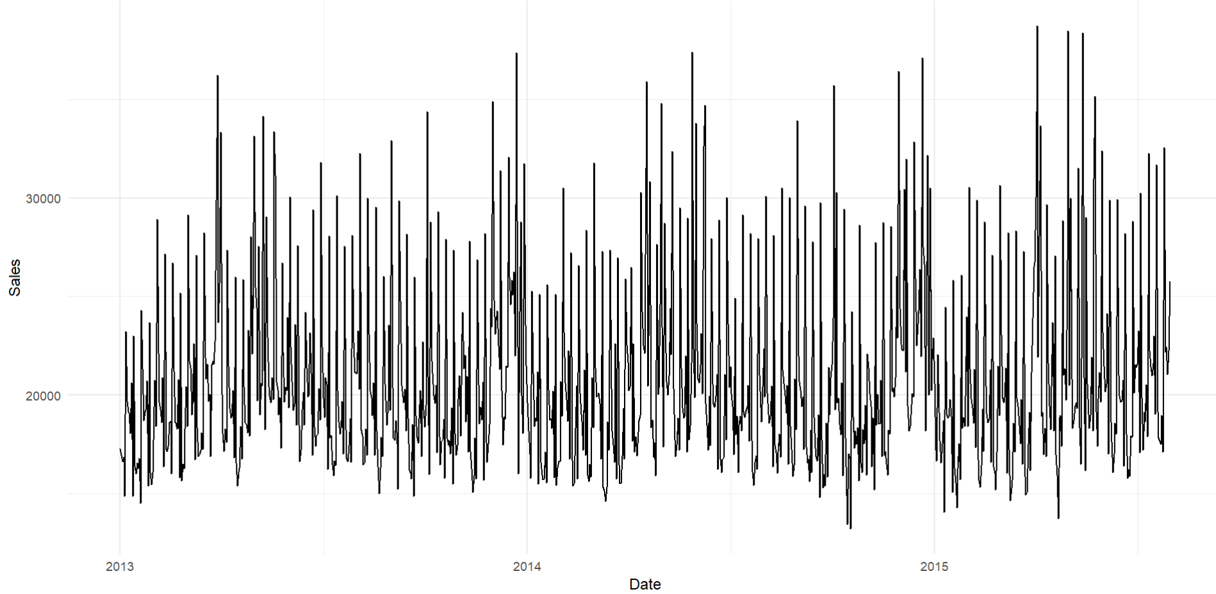
Time Series of Sales of store #262

Slide 6
Prophet Model
Prophet is an open-source forecasting tool developed by Facebook for time series forecasting, especially suitable for forecasting data with daily observations that display seasonality, trends, and other patterns.
Key Features:
1. Trend Detection: Automatically identifies and models overall trends over time.
2. Seasonality: Incorporates seasonal patterns such as yearly, weekly, and daily trends, and can handle holidays and other events.
3. Handling Missing Data and Outliers: Robust against missing data points and outliers.
4. Flexibility and Customization: Allows adjustments to seasonality, trend changepoints, and holidays to fine-tune forecasts.

Slide 7
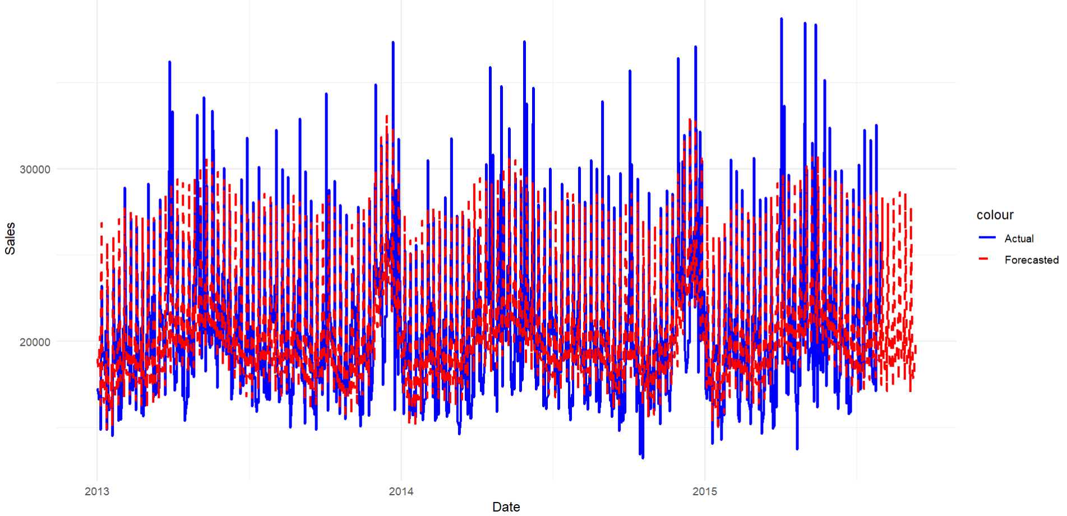
Actual vs Forecasted Sales

Slide 8
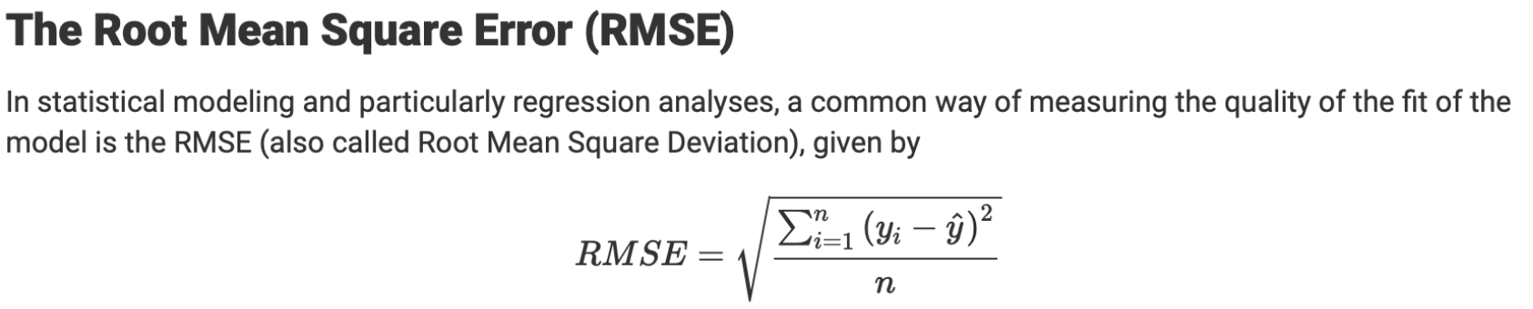
Evaluation Metrics

Slide 9

Results
RMSE : 2914.964
NRMSE: 0.114259
Training accuracy : 88.57%

